Slide 1
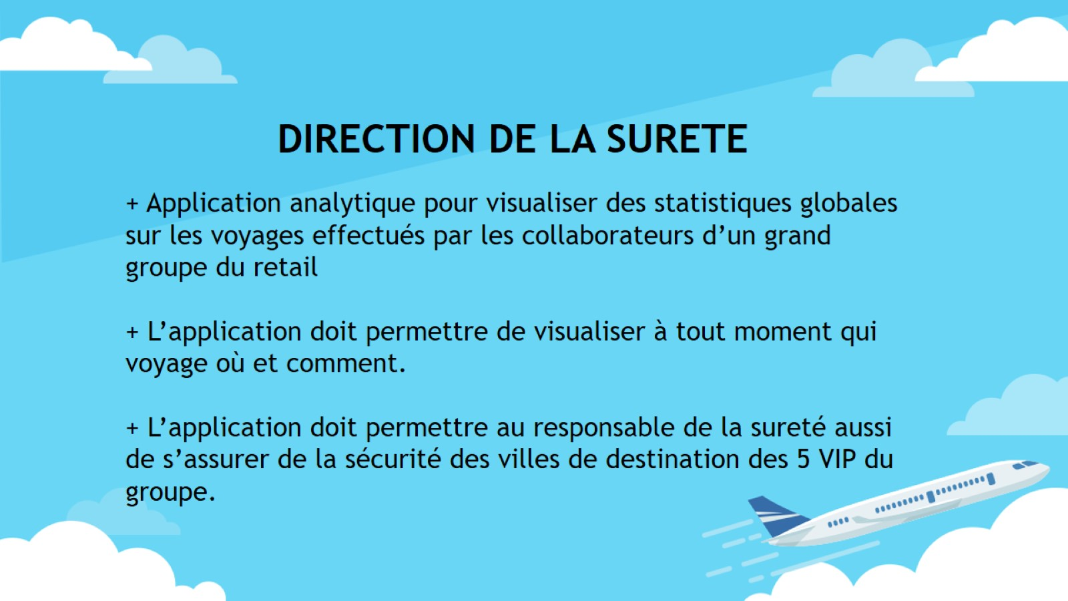

Slide 2
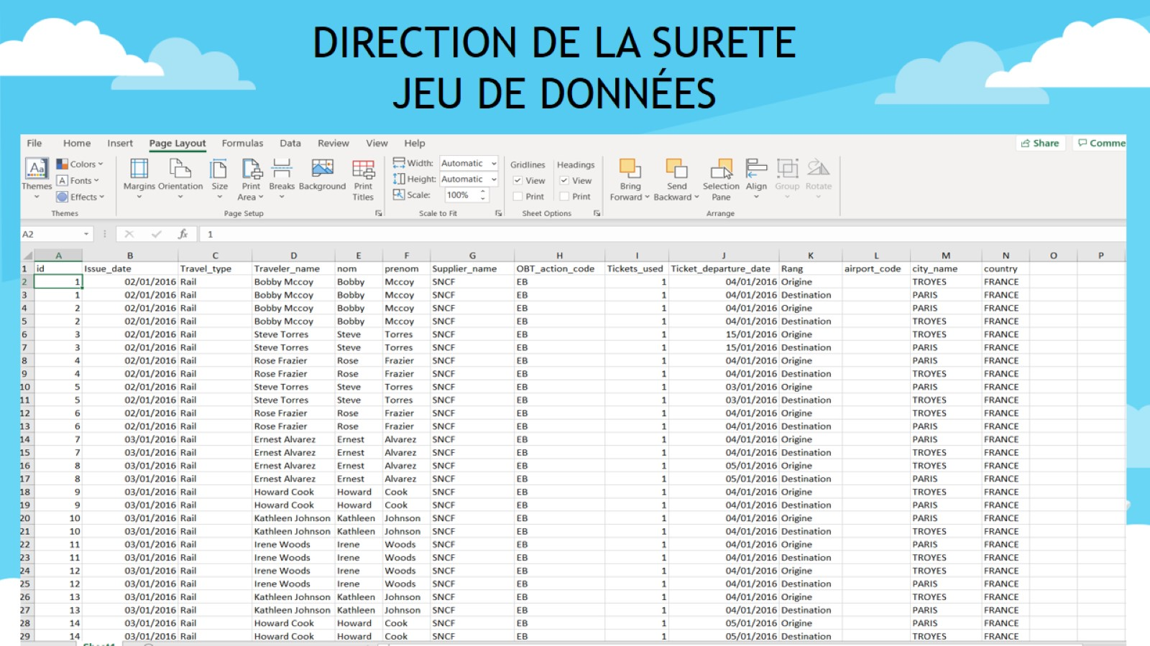

Slide 3

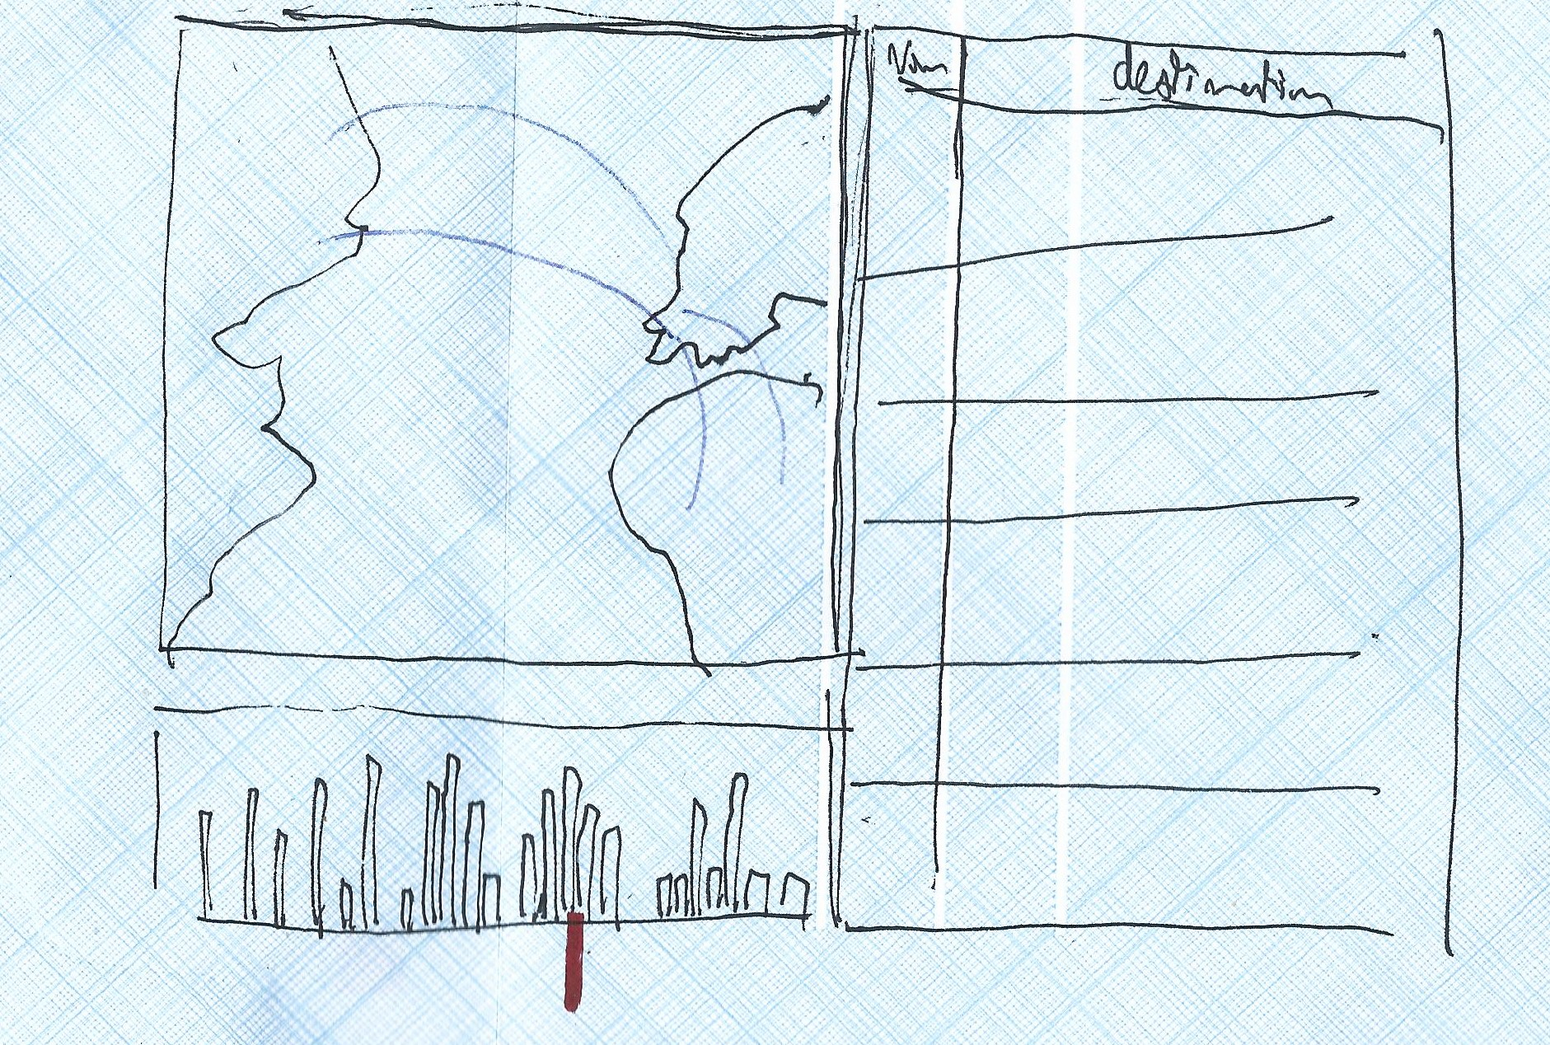

Slide 4
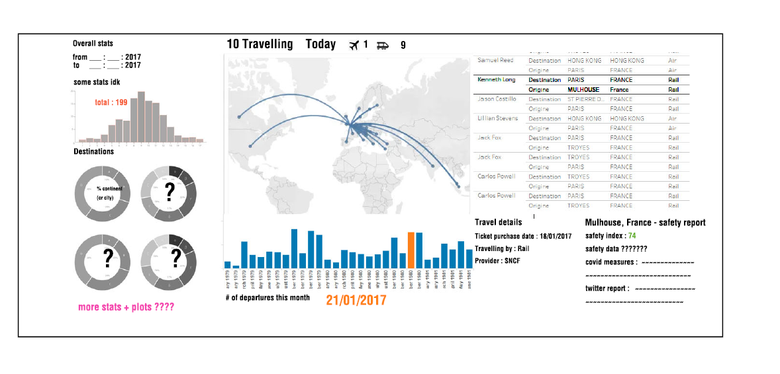

Slide 5
tinyurl.com/vizvoyages
tinyurl.com/vizvoyages
tinyurl.com/vizvoyages

Slide 6
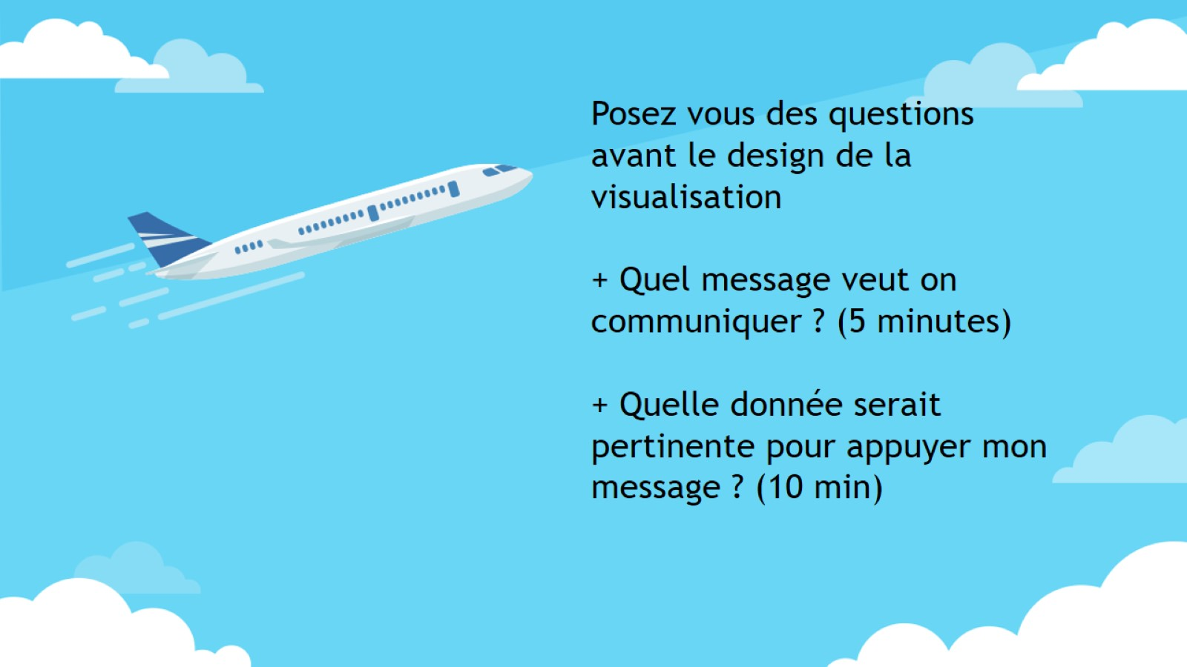

Slide 7


